Slide 1
Data Science
Session – 8
Date – 25th May, 2022

Slide 2
R - Data Frames
A data frame is a table or a two-dimensional array-like structure in which each column contains values of one variable and each row contains one set of values from each column.
Following are the characteristics of a data frame.
The column names should be non-empty.
The row names should be unique.
The data stored in a data frame can be of numeric, factor or character type.
Each column should contain same number of data items.

Slide 3
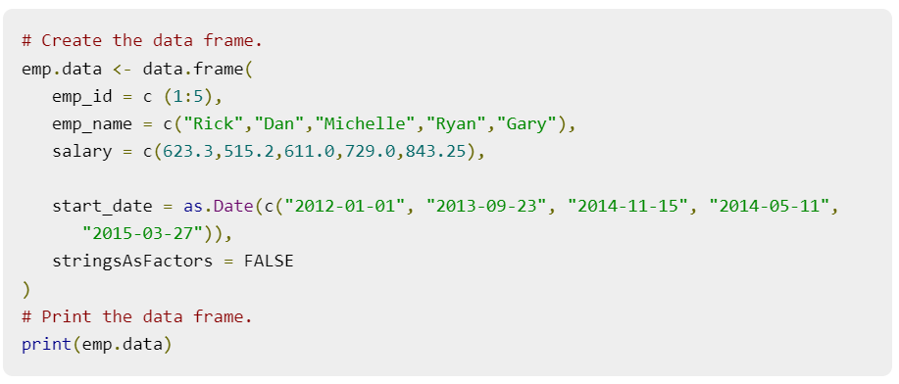
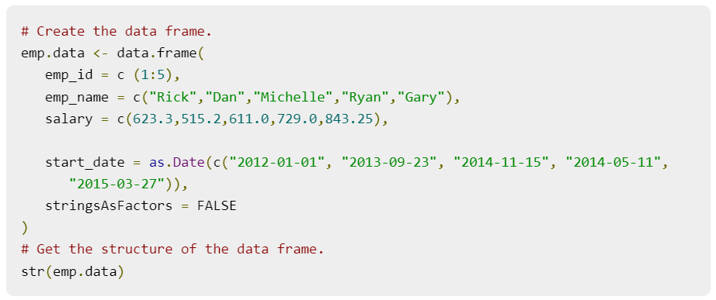
Create Data Frame
Get the Structure of the Data Frame
The structure of the data frame can be seen by using str() function.

Slide 4
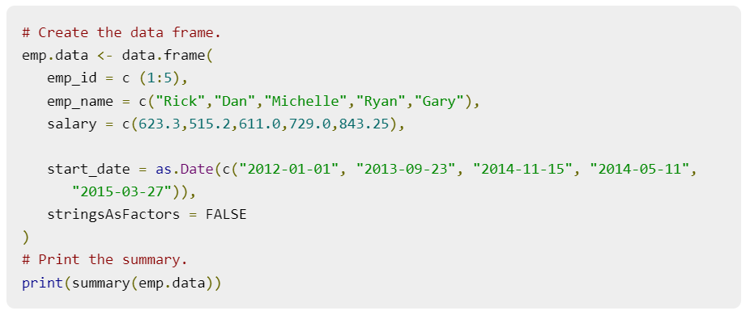
Summary of Data in Data Frame
The statistical summary and nature of the data can be obtained by applying summary() function.

Slide 5
Extract Data from Data Frame
Extract specific column from a data frame using column name.
Extract the first two rows and then all columns
Extract 3rd and 5th row with 2nd and 4th column
# Create the data frame.
emp.data <- data.frame(
emp_id = c (1:5),
emp_name = c("Rick","Dan","Michelle","Ryan","Gary"),
salary = c(623.3,515.2,611.0,729.0,843.25),
start_date = as.Date(c("2012- 01-01","2013-09-23","2014- 11-15","2014-05-11", "2015- 03-27")),
stringsAsFactors = FALSE )
# Extract Specific columns.
result <- data.frame(emp.data$emp_name,emp.data$salary)
print(result)
# Create the data frame.
emp.data <- data.frame(
emp_id = c (1:5),
emp_name = c("Rick","Dan","Michelle","Ryan","Gary"),
salary = c(623.3,515.2,611.0,729.0,843.25),
start_date = as.Date(c("2012-01- 01", "2013-09-23", "2014-11-15", "2014- 05-11", "2015-03- 27")),
stringsAsFactors = FALSE )
# Extract first two rows.
result <- emp.data[1:2,]
print(result)
# Create the data frame.
emp.data <- data.frame(
emp_id = c (1:5),
emp_name = c("Rick","Dan","Michelle","Ryan","Gary"),
salary = c(623.3,515.2,611.0,729.0,843.25),
start_date = as.Date(c("2012- 01-01", "2013-09- 23", "2014-11-15", "2014-05-11", "2015-03-27")),
stringsAsFactors = FALSE )
# Extract 3rd and 5th row with 2nd and 4th column.
result <- emp.data[c(3,5),c(2,4)]
print(result)

Slide 6
Expand Data Frame
Add Column
Add Row
Just add the column vector using a new column name.
To add more rows permanently to an existing data frame, we need to bring in the new rows in the same structure as the existing data frame and use the rbind() function.
# Create the first data frame.
emp.data <- data.frame(
emp_id = c (1:5),
emp_name = c("Rick","Dan","Michelle","Ryan","Gary"),
salary = c(623.3,515.2,611.0,729.0,843.25),
start_date = as.Date(c("2012-01-01", "2013-09-23", "2014- 11-15", "2014-05-11", "2015-03-27")),
dept = c("IT","Operations","IT","HR","Finance"),
stringsAsFactors = FALSE )
# Create the second data frame
emp.newdata <- data.frame(
emp_id = c (6:8),
emp_name = c("Rasmi","Pranab","Tusar"),
salary = c(578.0,722.5,632.8),
start_date = as.Date(c("2013-05-21","2013-07-30","2014- 06-17")),
dept = c("IT","Operations","Fianance"),
stringsAsFactors = FALSE )
# Bind the two data frames.
emp.finaldata <- rbind(emp.data,emp.newdata)
print(emp.finaldata)
# Create the data frame.
emp.data <- data.frame(
emp_id = c (1:5),
emp_name = c("Rick","Dan","Michelle","Ryan","Gary"),
salary = c(623.3,515.2,611.0,729.0,843.25),
start_date = as.Date(c("2012-01-01", "2013-09-23", "2014-11-15", "2014-05-11", "2015-03-27")),
stringsAsFactors = FALSE )
# Add the "dept" coulmn.
emp.data$dept <- c("IT","Operations","IT","HR","Finance")
v <- emp.data
print(v)

Slide 7
R - Packages
R packages are a collection of R functions, complied code and sample data. They are stored under a directory called "library" in the R environment. By default, R installs a set of packages during installation. More packages are added later, when they are needed for some specific purpose. When we start the R console, only the default packages are available by default. Other packages which are already installed have to be loaded explicitly to be used by the R program that is going to use them.
All the packages available in R language are listed at R Packages.

Slide 8
Check Available R Packages
Get the list of all the packages installed
Get library locations containing R packages
When we execute the above code, it produces the following result. It may vary depending on the local settings of your pc.
To get list of packages installed
Get all packages currently loaded in the R environment
library()
.libPaths()
search()
"C:/Program Files/R/R-3.2.2/library"

Slide 9
Install a New Package
Install directly from CRAN
Install package manually
Load Package to Library
Before a package can be used in the code, it must be loaded to the current R environment. You also need to load a package that is already installed previously but not available in the current environment.
A package is loaded using the following command −
The following command gets the packages directly from CRAN webpage and installs the package in the R environment. You may be prompted to choose a nearest mirror. Choose the one appropriate to your location.
Go to the link R Packages to download the package needed. Save the package as a .zip file in a suitable location in the local system.
Now you can run the following command to install this package in the R environment.
install.packages("Package Name")
# Install the package named #"XML".
install.packages("XML")
install.packages(file_name_with_path, repos = NULL, type = "source")
# Install the package named "XML"
Install.packages("E:/XML_3.98-1.3.zip", repos = NULL, type = "source")
library("package Name", lib.loc = "path to library")
# Load the package named "XML“
install.packages("E:/XML_3.98- 1.3.zip", repos = NULL, type = "source")

Slide 10
R - Data Reshaping
Data Reshaping in R is about changing the way data is organized into rows and columns. Most of the time data processing in R is done by taking the input data as a data frame. It is easy to extract data from the rows and columns of a data frame but there are situations when we need the data frame in a format that is different from format in which we received it. R has many functions to split, merge and change the rows to columns and vice-versa in a data frame.

Slide 11
Joining Columns and Rows in a Data Frame
We can join multiple vectors to create a data frame using the cbind()function. Also we can merge two data frames using rbind() function.
# Create vector objects.
city <- c("Tampa","Seattle","Hartford","Denver")
state <- c("FL","WA","CT","CO")
zipcode <- c(33602,98104,06161,80294)
# Combine above three vectors into one data frame.
addresses <- cbind(city,state,zipcode)
# Print a header.
cat("# # # # The First data frame\n")
# Print the data frame.
print(addresses)
# Create another data frame with similar columns
new.address <- data.frame(
city = c("Lowry","Charlotte"),
state = c("CO","FL"),
zipcode = c("80230","33949"),
stringsAsFactors = FALSE )
# Print a header.
cat("# # # The Second data frame\n")
# Print the data frame.
print(new.address)
# Combine rows form both the data frames.
all.addresses <- rbind(addresses,new.address)
# Print a header.
cat("# # # The combined data frame\n")
# Print the result.
print(all.addresses)

Slide 12
Merging Data Frames
We can merge two data frames by using the merge() function. The data frames must have same column names on which the merging happens.
In the example below, we consider the data sets about Diabetes in Pima Indian Women available in the library names "MASS". we merge the two data sets based on the values of blood pressure("bp") and body mass index("bmi"). On choosing these two columns for merging, the records where values of these two variables match in both data sets are combined together to form a single data frame.
library(MASS)
merged.Pima <- merge(
x = Pima.te,
y = Pima.tr,
by.x = c("bp", "bmi"),
by.y = c("bp", "bmi") )
print(merged.Pima)
nrow(merged.Pima)

Slide 13
Melting and Casting
Melt the Data
Cast the Molten Data
Now we melt the data to organize it, converting all columns other than type and year into multiple rows.
We can cast the molten data into a new form where the aggregate of each type of ship for each year is created. It is done using the cast() function.
molten.ships <- melt(ships, id = c("type","year"))
print(molten.ships)
recasted.ship <- cast(molten.ships, type+year~variable,sum)
print(recasted.ship)
Note - We consider the dataset called ships present in the library called "MASS".

Slide 14
R - CSV Files
In R, we can read data from files stored outside the R environment. We can also write data into files which will be stored and accessed by the operating system. R can read and write into various file formats like csv, excel, xml etc.
In this topic we will learn to read data from a csv file and then write data into a csv file. The file should be present in current working directory so that R can read it. Of course we can also set our own directory and read files from there.

Slide 15
Getting and Setting the Working Directory
You can check which directory the R workspace is pointing to using the getwd() function. You can also set a new working directory using setwd()function.
# Get and print current working directory.
print(getwd())
# Set current working directory.
setwd("/web/com")
# Get and print current working directory.
print(getwd())

Slide 16
Reading a CSV File
Analyzing the CSV File
Following is a simple example of read.csv() function to read a CSV file available in your current working directory −
By default the read.csv() function gives the output as a data frame. This can be easily checked as follows. Also we can check the number of columns and rows.
data <- read.csv("input.csv")
print(data)
data <- read.csv("input.csv")
print(is.data.frame(data))
print(ncol(data))
print(nrow(data))

Slide 17
Some Functions and Filters in dataframe
Get the maximum salary
Get the details of the person with max salary
Get all the people working in IT department
Get the persons in IT department whose salary is greater than 600
# Create a data frame.
data <- read.csv("input.csv")
# Get the max salary from data frame.
sal <- max(data$salary)
print(sal)
# Create a data frame.
data <- read.csv("input.csv")
# Get the max salary from data frame.
sal <- max(data$salary)
# Get the person detail having max salary.
retval <- subset(data, salary == max(salary))
print(retval)
# Create a data frame.
data <- read.csv("input.csv")
retval <- subset( data, dept == "IT")
print(retval)
# Create a data frame.
data <- read.csv("input.csv")
info <- subset(data, salary > 600 & dept == "IT")
print(info)

Slide 18
Writing into a CSV File
R can create csv file form existing data frame. The write.csv() function is used to create the csv file. This file gets created in the working directory.
# Create a data frame.
data <- read.csv("input.csv")
retval <- subset(data, as.Date(start_date) > as.Date("2014-01-01"))
# Write filtered data into a new file.
write.csv(retval,"output.csv") #this will create a index column as well
#use this to avoid index column
write.csv(retval,"output.csv", row.names = FALSE)
newdata <- read.csv("output.csv")
print(newdata)

